Slide 1
Never Fly Without the Jesus Nut

Slide 2
Note: After you download the slideshow, you may also need to download some videos from YouTube & add them into this PowerPoint. This tool can help you: Free YouTube Download
We present these messages in outdoor venues using the SonShineTent. Watch the video of our service that goes with this message, click here: http://campaignkerusso.org/?p=13419
We would love to know more about the people who download our lessons & sermons. We invite you to email us & let us know where & how you use them.
info@campaignkerusso.org

Slide 3
Welcome All

Slide 4
Let’s Begin With Prayer

Slide 5
Never Fly Without the Jesus Nut

Slide 6
The Jesus Nut
Jesus Nut
The Cockpit is like our
body—where our soul sits.

Slide 7
The Jesus Nut Without it helicopters would fall apart

Slide 8
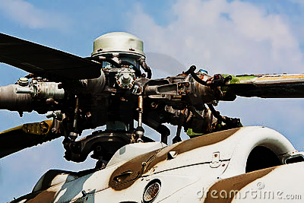
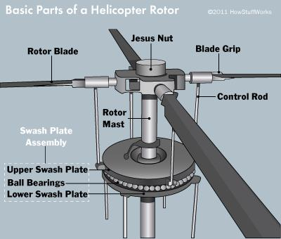
The “Jesus Nut” is a helicopter part that holds all the flying parts together.
Jesus Nut

Slide 9
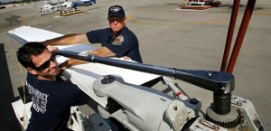
Jesus Nut
One of the mechanics working on the first helicopter was heard to say, “We had better pray to Jesus that this nut holds the whole thing together!” Ever since then, helicopter people call it, “The Jesus Nut.”

Slide 10
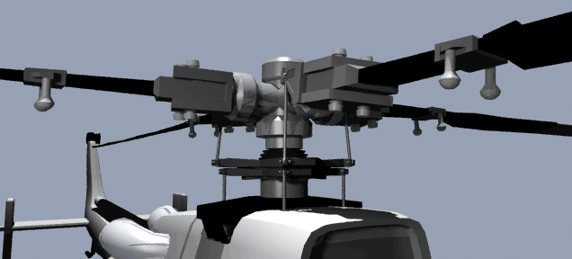
Without it, the whole thing will fall apart and crash.

Slide 11
“Jesus existed before everything and holds everything together.”
Col. 1:17

Slide 12
Without Jesus, our lives will fall apart and crash.
“He raises the poor from the dust; he lifts the needy from their misery.”
Ps. 113:7 (GNT)

Slide 13
Video: Flying Without the Jesus Nut
Video Goes Here Title: Flying Without the Jesus Nut Download Here:
https://youtu.be/gnx3QeJWk7Y

Slide 14
The Jesus Nut
The Jesus Nut is like Jesus
The Cockpit is like our
body—where our soul sits.

Slide 15
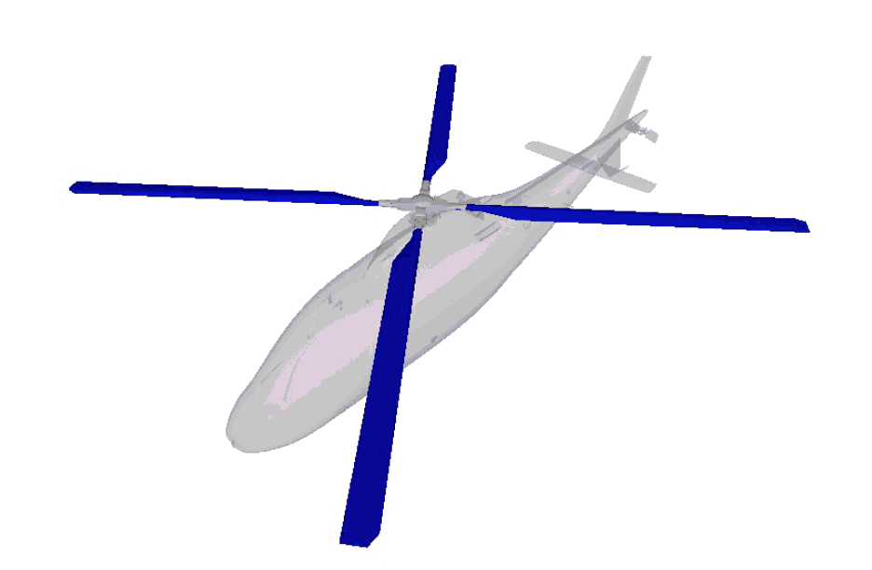
The rotor blades give the helicopter flight.

Slide 16
“The Holy Spirit gives life”
Jn. 6:23 (NIV)

Slide 17
The Holy Spirit gives life to our souls. Without the Holy Spirit we are not living souls and cannot fly to Heaven.

Slide 18
The Jesus Nut
The Roto Blades
are like the life breathing Holy Spirit
The Jesus Nut is like Jesus
The Cockpit is like our
body—where our soul sits.

Slide 19
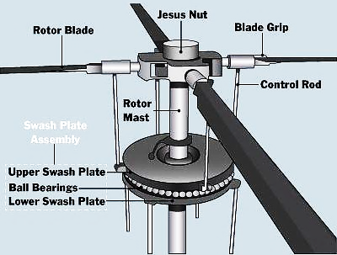
The Mast attaches both the Jesus Nut & the Rotor Blades to the Cockpit.

Slide 20
The Cross attaches Jesus & the Holy Spirit to us.
“He also brought them back to God… by his cross...”
Eph. 2:16 (GW)

Slide 21
We can only find Jesus & eternal life at the foot of the cross. It is the mast that connects our soul to God.

Slide 22
The Jesus Nut
The Roto Blades
are like the life breathing Holy Spirit
The Jesus Nut is like Jesus
The Mast is like the Cross of Jesus — connecting us to God
The Cockpit is like our
body—where our soul sits.

Slide 23
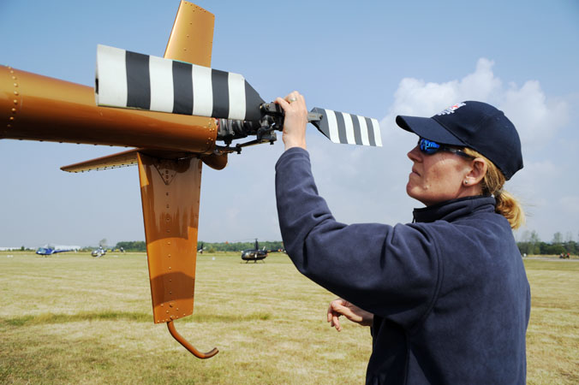
The Tail Rotor keeps the craft flying straight. Without it the copter would fly around in circles!

Slide 24
The Word of God shows us the way and keeps us from going in circles.
“The teachings of his God are in his heart. His feet do not slip.”
Ps 37:31 (GW)

Slide 25
The Jesus Nut
The Roto Blades
are like the life breathing Holy Spirit
The Jesus Nut is like Jesus
The Mast is like the Cross of Jesus — connecting us to God
The Cockpit is like our body—where our soul sits.
The Rotor Tail is like the Word of God

Slide 26
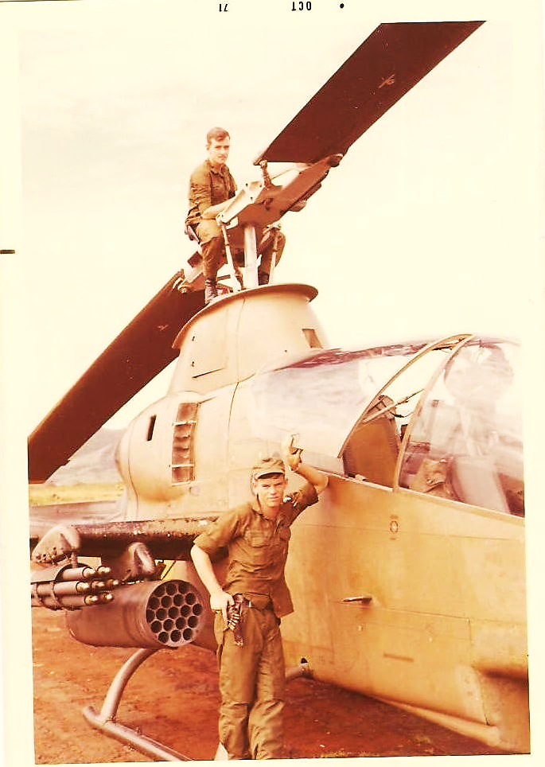
Helicopter pilots do a safety preflight at every stop.
The most important thing to check is the Jesus Nut. Is it still on tight?

Slide 27
Video: Preflight Check
Video Goes Here Title: Preflight Check Download Here:
https://youtu.be/Vg0EBluQwwo

Slide 28
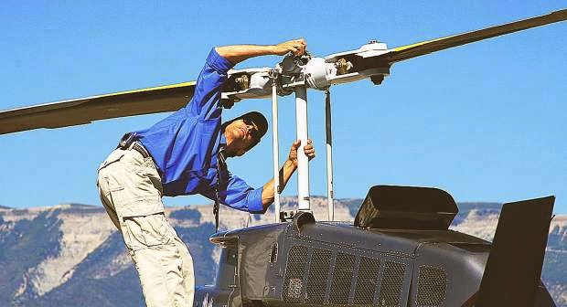
We also need to do regular preflight checks on our spiritual condition.
Go to church, pray at the altar, pray by our beds, study our bibles, go back to the foot of the cross, repent—check and recheck that our Savior Jesus is well attached to our souls.

Slide 29
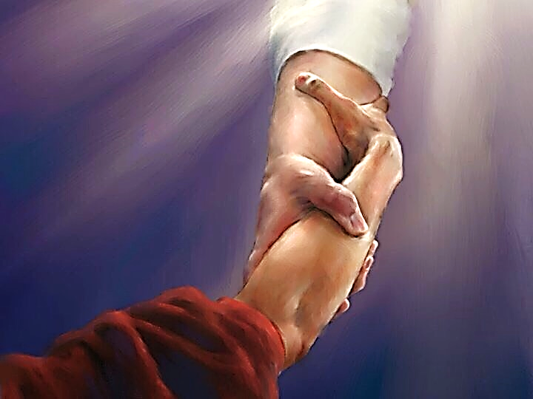
Ask yourself: Am I flying safely?
Is my Jesus connection tight?

Slide 30
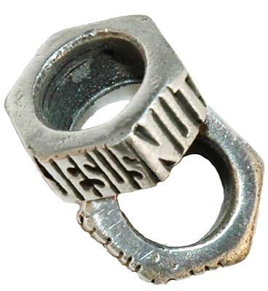
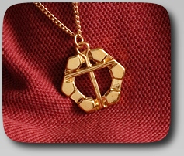
Some Crafts People Have Made

Slide 31
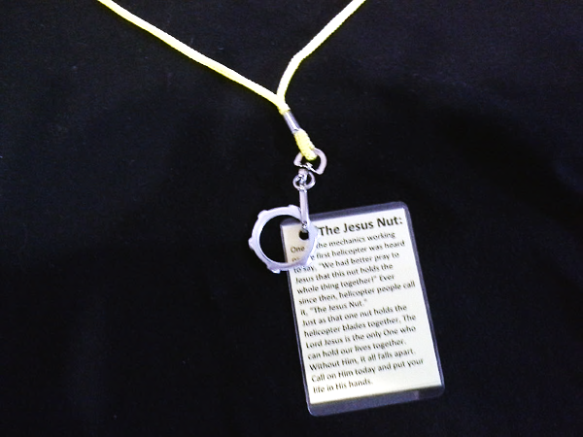
Our Special Gift to You: Jesus Nut Reminder Pendant

Slide 32
Song: Lord I Need You
Video Goes Here Title: Lord I Need You Download Here:
https://youtu.be/LuvfMDhTyMA

Slide 34
Is Jesus Speaking
to You?
“They began telling each other how their hearts had felt strangely warm as he talked with them…”
Lk.24:32 (TLB)
John Wesley Said:
“…the preacher was describing the change which God works in the heart… and I felt my heart strangely warmed.”
Jesus makes His presence Known by a small voice!

Slide 35
What is the Sinner‘s Prayer?
This is a prayer we can pray when we are ready to admit we are sinners and need Christ’s forgiveness.
It must be prayed with faith in our hearts and a readiness to have a life-changing encounter with Jesus Christ.

Slide 36
A prayer of faith → Pray this prayer if :
If you never have before
You have in the past, but you think it would mean more today
You have been walking afar off and you want to come back
You want to set an example & show others how it is done
You just like to give your heart to Jesus again & again
Faith

Slide 37
Important Questions
Do you want to know Jesus as your Savior right now?
Do you believe He died to save you from your sins & that He rose from the dead?
Do you believe that He is here, waiting to save you right now?

Slide 38
We Declare Our Faith Publicly Because Jesus Declared His LOVE Publicly
“If you stand before others and are willing to say you believe in me, then I will tell my Father in heaven that you belong to me.” Mat 10:32

Slide 39
The Prayer of a Sinner Turning to Jesus
Dear Jesus, I know that I have sinned against You and that my sins separate me from You.
I am truly sorry.
Right now, I turn away from my sinful past .
Please forgive me, and help me to keep from sin.
I believe You died for my sins.
I Believe You rose from the dead, you are alive, and you hear this prayer from my heart.
I invite You Jesus to be both my Savior and the Lord of my life.
I want You to rule my life from now on.

Slide 40
“But some people did accept him. They believed in him, and he gave them the right to become children of God.”
John 1:12

Slide 42
“If you openly say, ‘Jesus is Lord’ and believe in your heart that God raised him from death, you will be saved.”
Rom. 10:9
What did you learn today?
What is the meaning of the Jesus Nut?
What have you been thinking about God lately?
What do you want to tell the world about Jesus?

Slide 43
Let’s Close in Prayer

Slide 44
Note: After you download the slideshow, you may also need to download some videos from YouTube & add them into this PowerPoint. This tool can help you: Free YouTube Download
We present these messages in outdoor venues using the SonShineTent. Watch the video of our service that goes with this message, click here: http://campaignkerusso.org/?p=13419
We would love to know more about the people who download our lessons & sermons. We invite you to email us & let us know where & how you use them.
info@campaignkerusso.org

